Slide 1
PTA/OTA 106 Unit 1 Lecture 1A

Slide 2
PTA 106 Regional Anatomy and Physiology
Regional Anatomy- Focuses on the anatomical organization of specific areas of the body, such as the head, neck, or trunk. Many advanced courses in anatomy stress a regional approach, because it emphasizes the spatial relationships between structures important to clinical settings.

Slide 3
PTA 106 Regional Anatomy and Physiology
Regional approach for the three units of this class:
Head and Neck A&P
Thoracic and Abdominopelvic A&P
Upper and Lower Extremities A&P

Slide 4
PTA 106 Regional Anatomy and Physiology
Systems covered regionally:
Digestive system
Respiratory system
Cardiovascular system
Endocrine system
Urinary system
Reproductive system
Muscles
Skeletal
Nervous

Slide 5
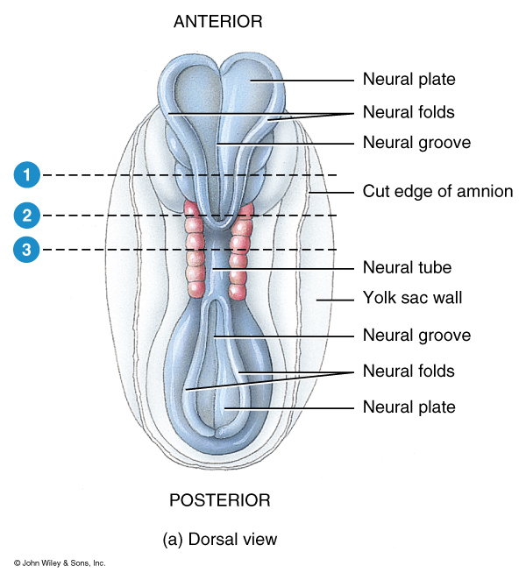
Embryonic Development of the Brain and Spinal Cord

Slide 6
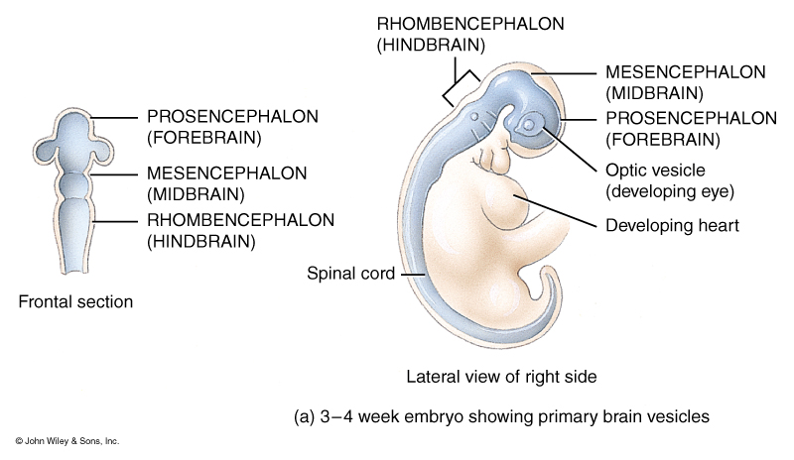
Embryonic Development of the Brain and Spinal Cord, Primary Structures

Slide 7
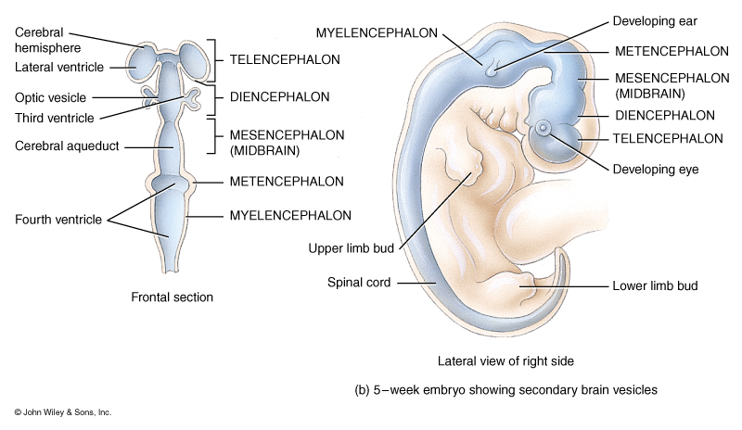
Embryonic Development of the Brain and Spinal Cord, Secondary Structures

Slide 8
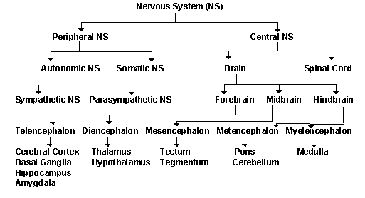
Flow Chart for the Nervous System

Slide 9
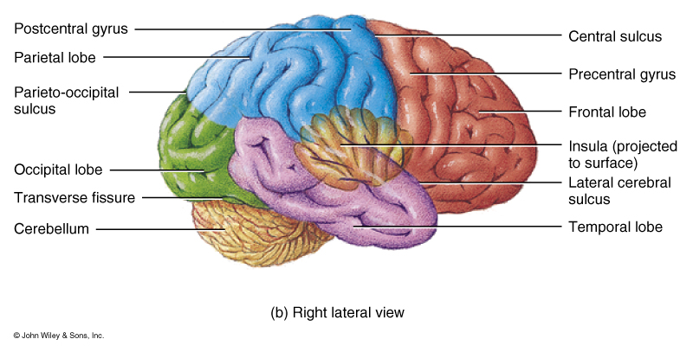
Lobes of the Cerebral Cortex

Slide 10
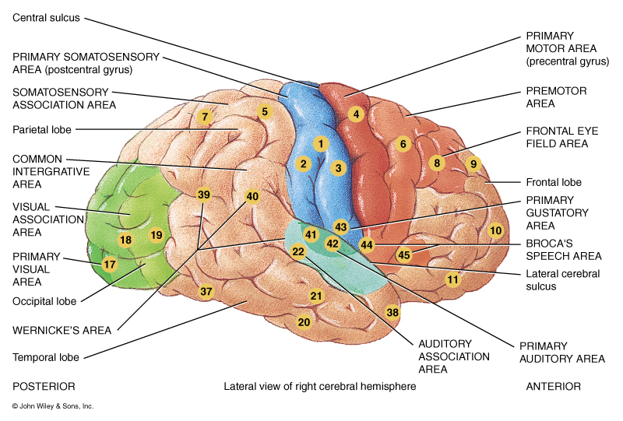
Functional Areas of the Cerebral Cortex

Slide 11
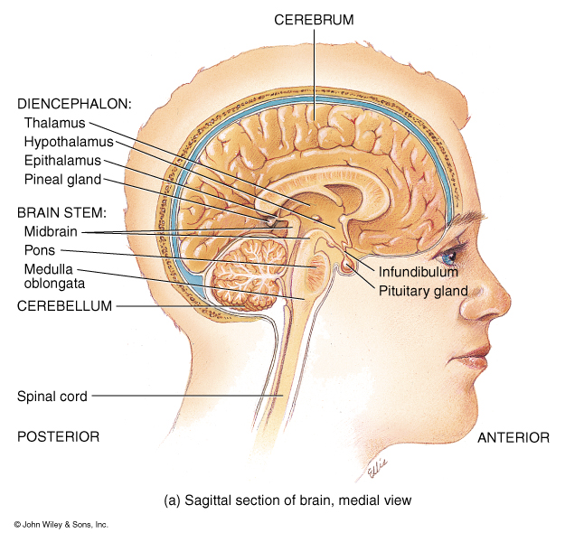
Major Internal Structures of the Brain as seen in mid-sagittal
Septum pellucidum
Corpus
Callosum

Slide 12
Major Structures of the Brain
Fornix
Intermediate mass of
the Thalamus

Slide 13
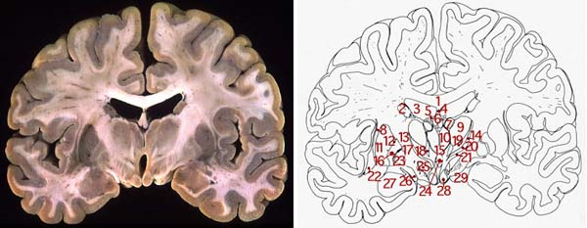
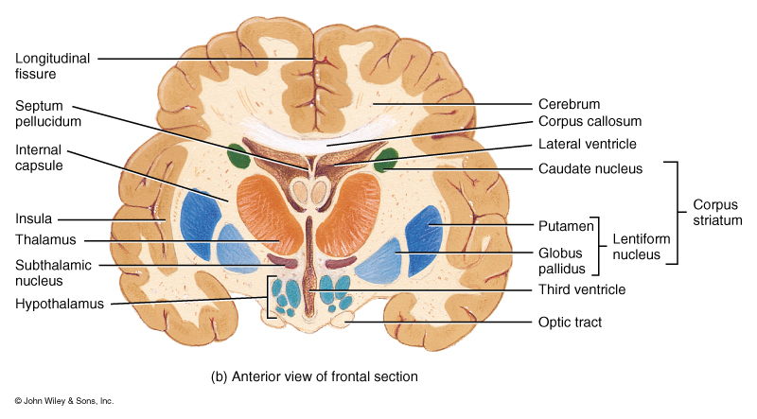
Major Structures of the Brain as seen in Frontal Section

Slide 14
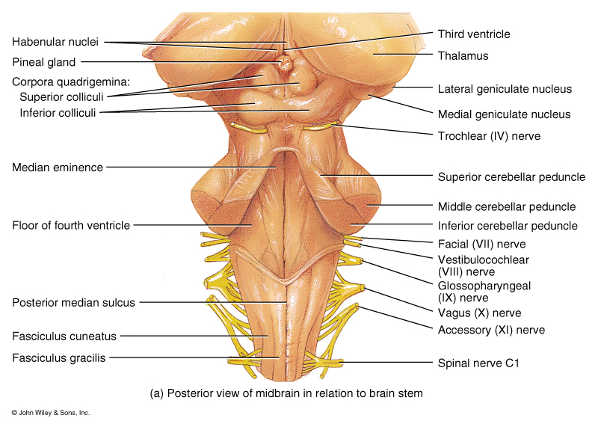
Major Structures of the Brain

Slide 15
Cerebrospinal Fluid “CSF”
Blood-Brain Barrier: formed by tight junction of the endothelial
cells of capillaries, tight junction between
ependymal cells and astrocytes. These three tissues
are involved in production of CSF.
Total Volume: 80-150 ml
Production rate: 20ml/hr.
Composition: glucose, proteins, lactic acid, urea
cations (Na+, K+, Ca2+, Mg2+)
anions (Cl-, HCO3-)
Functions:
1. Mechanical protection
2. Chemical protection
hyponatremia, hypernatremia
3. Circulation

Slide 16
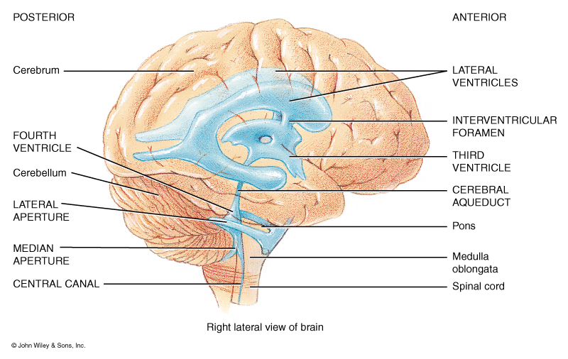
Organization of Ventricles of the Brain

Slide 17
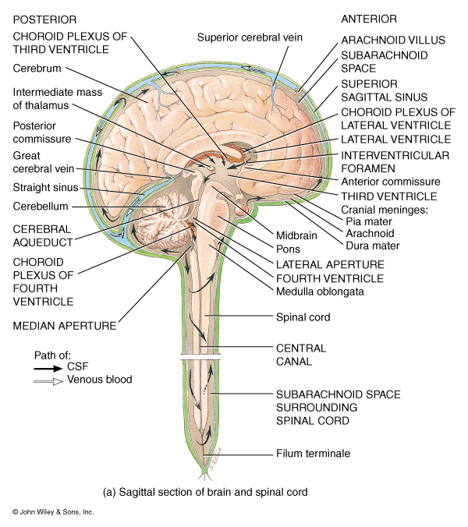
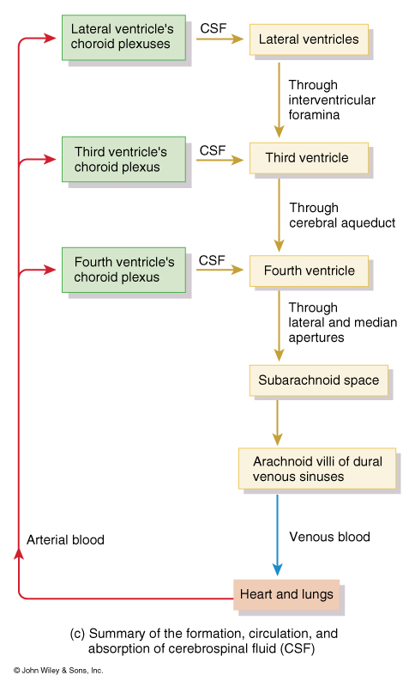

Slide 18
Cranial Nerves- 12 pairs

Slide 19
Structural and Functional areas of the Medulla Oblongata
Cardiovascular Center:
Regulates the rate and force of the heartbeat and the diameter of blood vessels
Medullary Rhythmicity Area:
adjusts the basic rhythm of breathing via inspiratory and expiratory areas.
Other centers for vomiting,
coughing, and sneezing

Slide 20
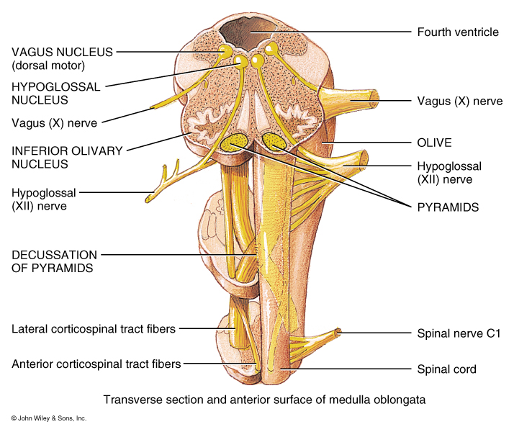
Structural and Functional areas of the Medulla Oblongata
Pyramids:
Axons from the largest motor tracts from the cerebrum to the Spinal Cord.
Decussation of Pyramids:
Crossing of the motor tracts of the pyramids
Nucleus Gracilis: Neuron cells bodies of second order neurons (sensory info)
Nucleus Cuneatus: Neuron cells bodies of second order neurons (sensory info)

Slide 21
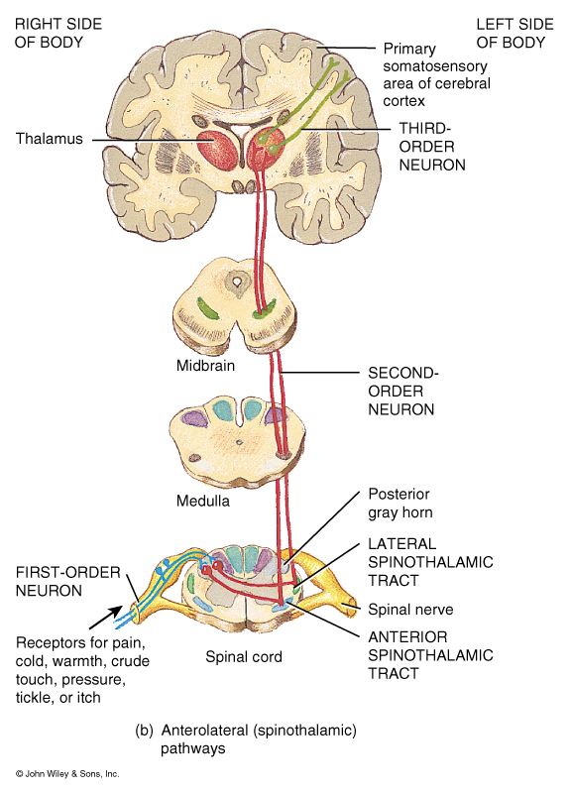
Organization of
Sensory or Ascending
Pathways

Slide 22
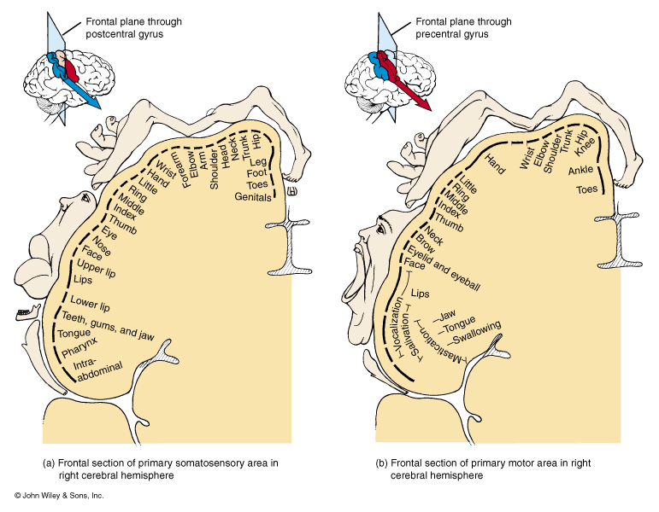

Slide 23
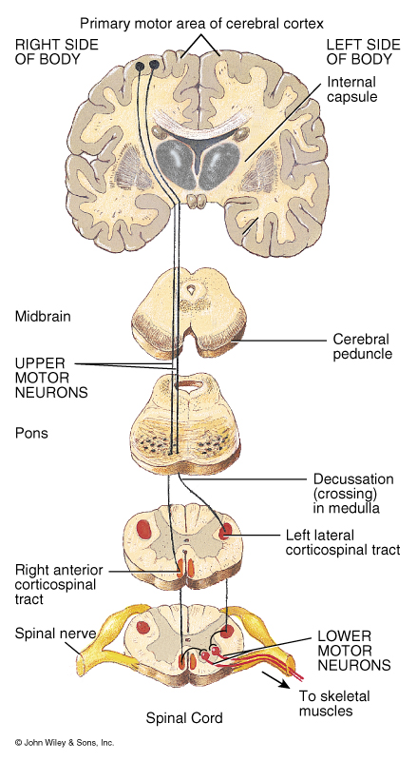

Slide 25
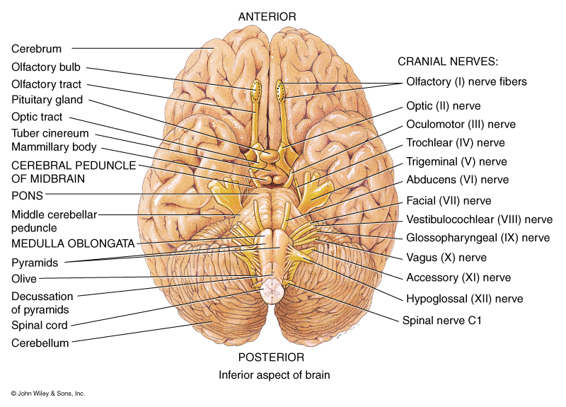
Structural and Functional areas of the Medulla Oblongata
Contains the Nuclei of five cranial nerves:
12. Hypoglossal
Origin for impulses that control tongue movement for speech and swallowing
11. Spinal Accessory
Origin for nerve impulses that control swallowing.

Slide 26
Structural and Functional areas of the Medulla Oblongata
Contains the Nuclei of five cranial nerves:
10. Vagus
Sensory and motor impulses for viscera
9. Glossopharyngeal
Relay sensory and motor impulses related to taste, swallowing, and salivation
8. Vestibulocochlear
Receive sensory and motor impulses for the cochlea

Slide 27
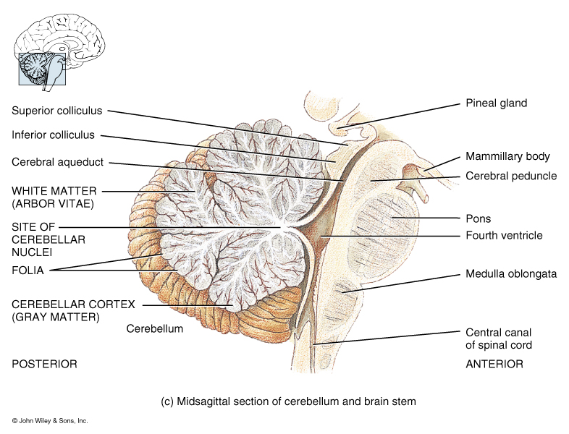
Structural and Functional areas of the Pons
Bridge that connects medulla and superior brain structures
Longitudinal axons of ascending sensory and descending motor tracts
Transverse axons connect the right and left sides of the cerebellum
Pneumotaxic Area:
transmits inhibitory impulses to the inspiratory area of the Medullary rhythmicity area

